Slide 1
The Clever Adventurer
Rascanu Dragos
FILS

Slide 2
Content
Languages
Advantages
Disadvantages
Comparison with other games
objectives
Presentation of the application
conclusion

Slide 3
Languages used
Programming languages:
Markup languages:
Frameworks
Javascript
MySQL
HTML
CSS
Node.js
Mysql2
Passport

Slide 4
ADVANTAGES
Integration with Web Technologies
Platform Independence
Easy Distribution
JavaScript is a language that can run on multiple platforms, including web browsers and mobile devices. Thus, this game could be accessible to a wide audience in comparison to game written in c#, c++, python or java.
The game is a browser-based game. This means that it can be easily distributed by hosting it on a web server or embedding it in a website. Players can access the game by simply visiting a URL.
JavaScript can seamlessly integrate with other web technologies like HTML and CSS. This allows you to incorporate multimedia elements, create user interfaces, and leverage the power of CSS for visual effects, animations, and responsive layouts.

Slide 5
ADVANTAGES
Educational Value
Broad Appeal
Cultural Awareness
A general knowledge 2D game can be a fun and engaging way to learn and expand knowledge. Players are challenged with questions from various subjects, such as history, science, literature, or geography.
General knowledge games have a wide appeal as they cater to a broad audience. People of different ages, backgrounds, and interests can enjoy playing and learning from them.
This game covers various cultural aspects, including art, music, traditions, and historical events from different regions of the world.

Slide 6
DISADVANTAGES
Limited Access to System Resources
Performance Limitations
Browser Compatibility
JavaScript is an interpreted language, which can result in lower performance compared to compiled languages like C++ or C#.
JavaScript games running in a browser have limited access to system resources like file systems or hardware capabilities.
Different web browsers may have varying levels of support for JavaScript features and APIs. This can lead to inconsistencies in how your game runs across different browsers, requiring additional testing and compatibility fixes.

Slide 7
DISADVANTAGES
Game is in alpha
Learning Gap
Designing a game that appeals to a wide range of players can be challenging, and it's difficult to create content that is both challenging for advanced learners and accessible for beginners.
This game is far from being done and there are many things that I would want to implement in the future, as for now, it only has one level and the account part of the project is not really used.

Slide 8
COMPARISON with other games
Super Mario
triviador
A suitable comparison would be with the Super Mario games. Although it contains less mechanics than these games, The clever adventurer is aimed towards combining both the gaming and the learning experience.
Another good comparison would be with the Triviador, which is a “test your knowledge” game. A difference would be that Triviador is an online game and could engage more the players through competitiveness, which mine does not. Yet, mine is much more dynamic and engaging from the gaming perspective. It could be said that The Clever Adventurer somewhat combines these two games, bringing an unique experience for the player.

Slide 9
objectives
Add another attack
Add levels with increased difficulty
Add a level system for the user
Change the particles
Add a scoreboard
Add audio(soundtrack and environment)

Slide 10
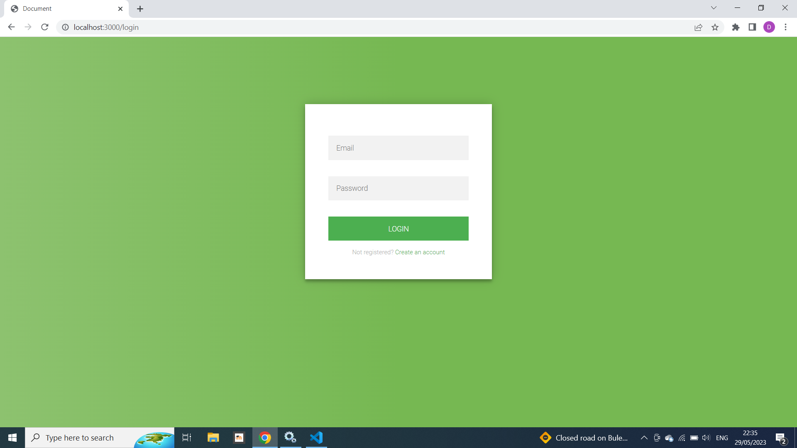
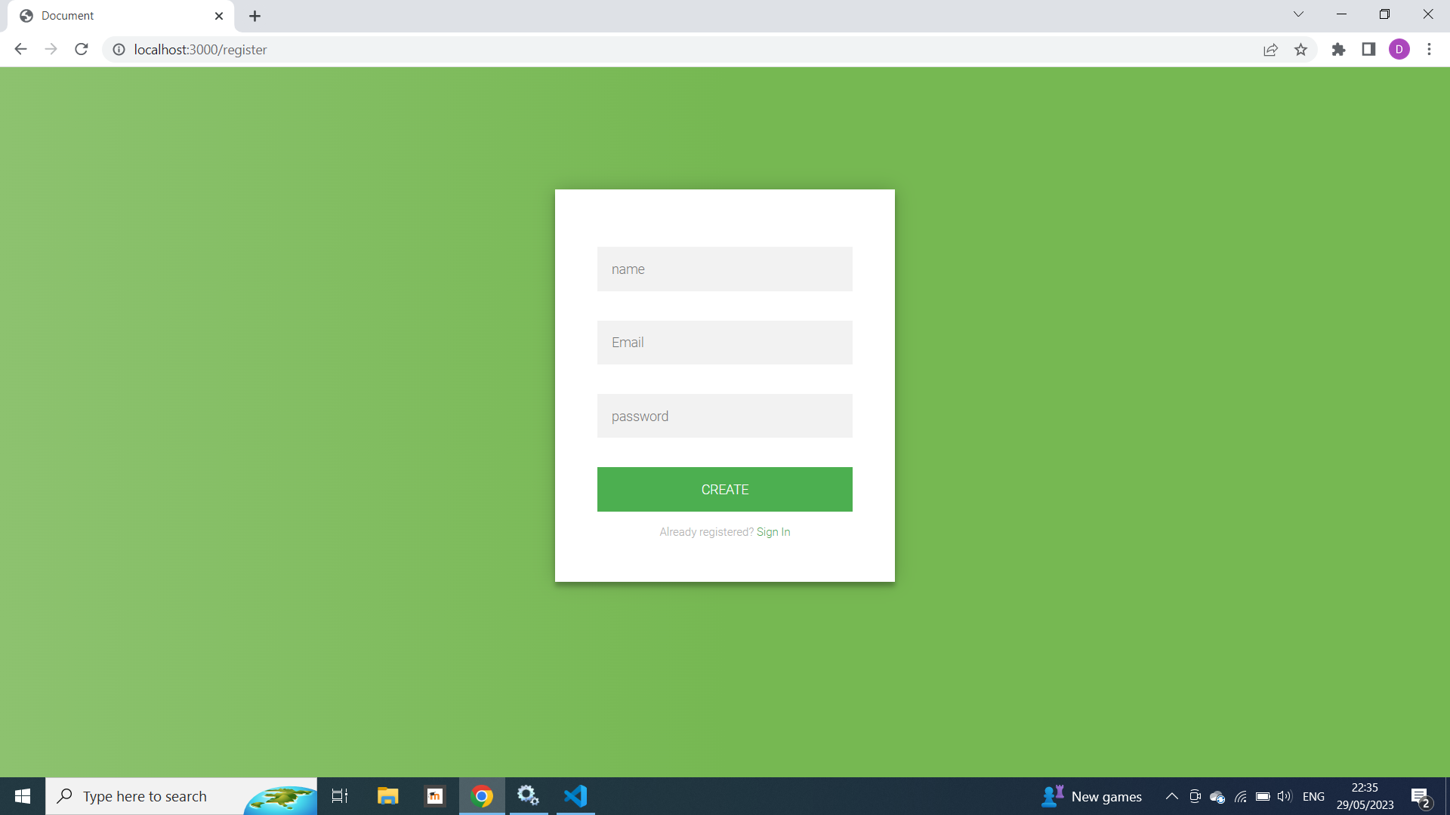
Login and register page
A simple login page which checks if the email is in the database and if the password corresponds to that email.
A register page in which the password, email, and username are added in the database. The idea of creating an user was for adding the future objectives of a level system and a scoreboard.

Slide 11
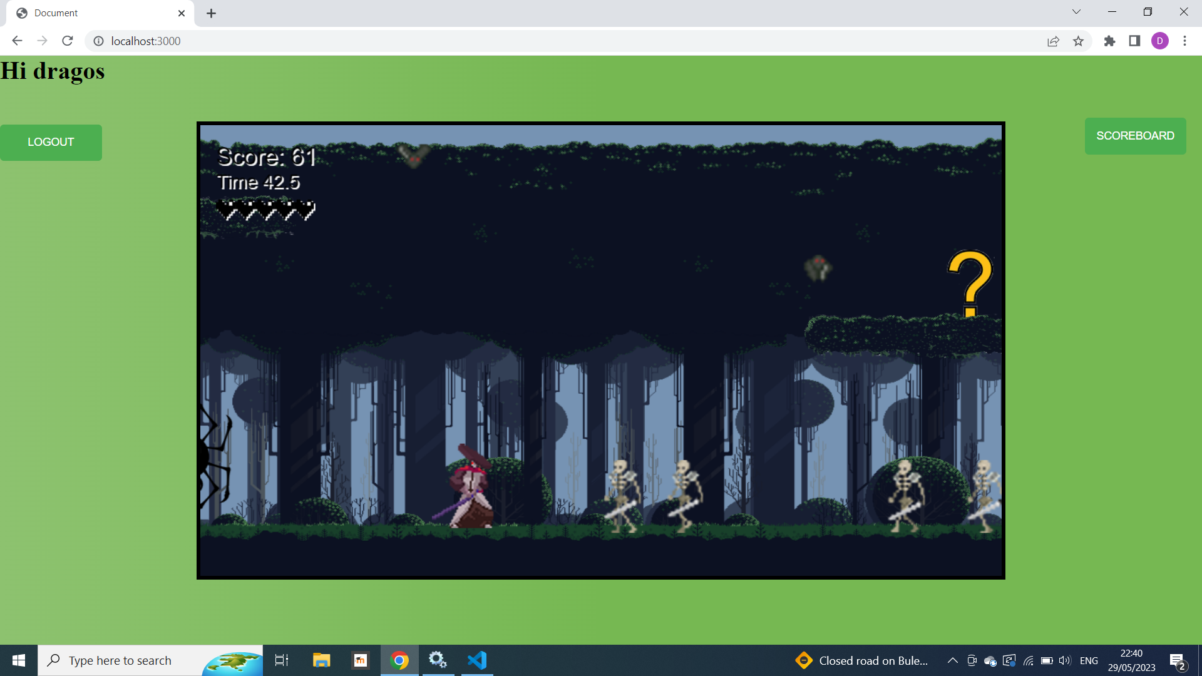
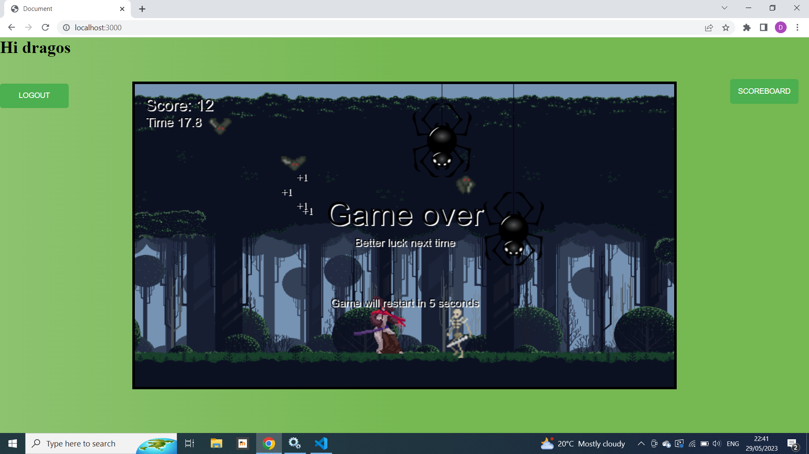
Gameplay and ui
Screenshots from the game. On the top left side, there are three elements: the scoreboard, the time and the lives. User can win the game by reaching the end of the level or by having more than 50 score points by the end of the 50 seconds limit. Player can lose if it does not have any more lives or if it has less than 50 points by the end of the limit. There is a logout button for logging out and also a scoreboard button which does not work yet. After the game ends, it will automatically restart after 5 seconds.
The game includes background layers, platforms, challenges and four types of enemies, all of which were either edited or made by me in photoshop.

Slide 12
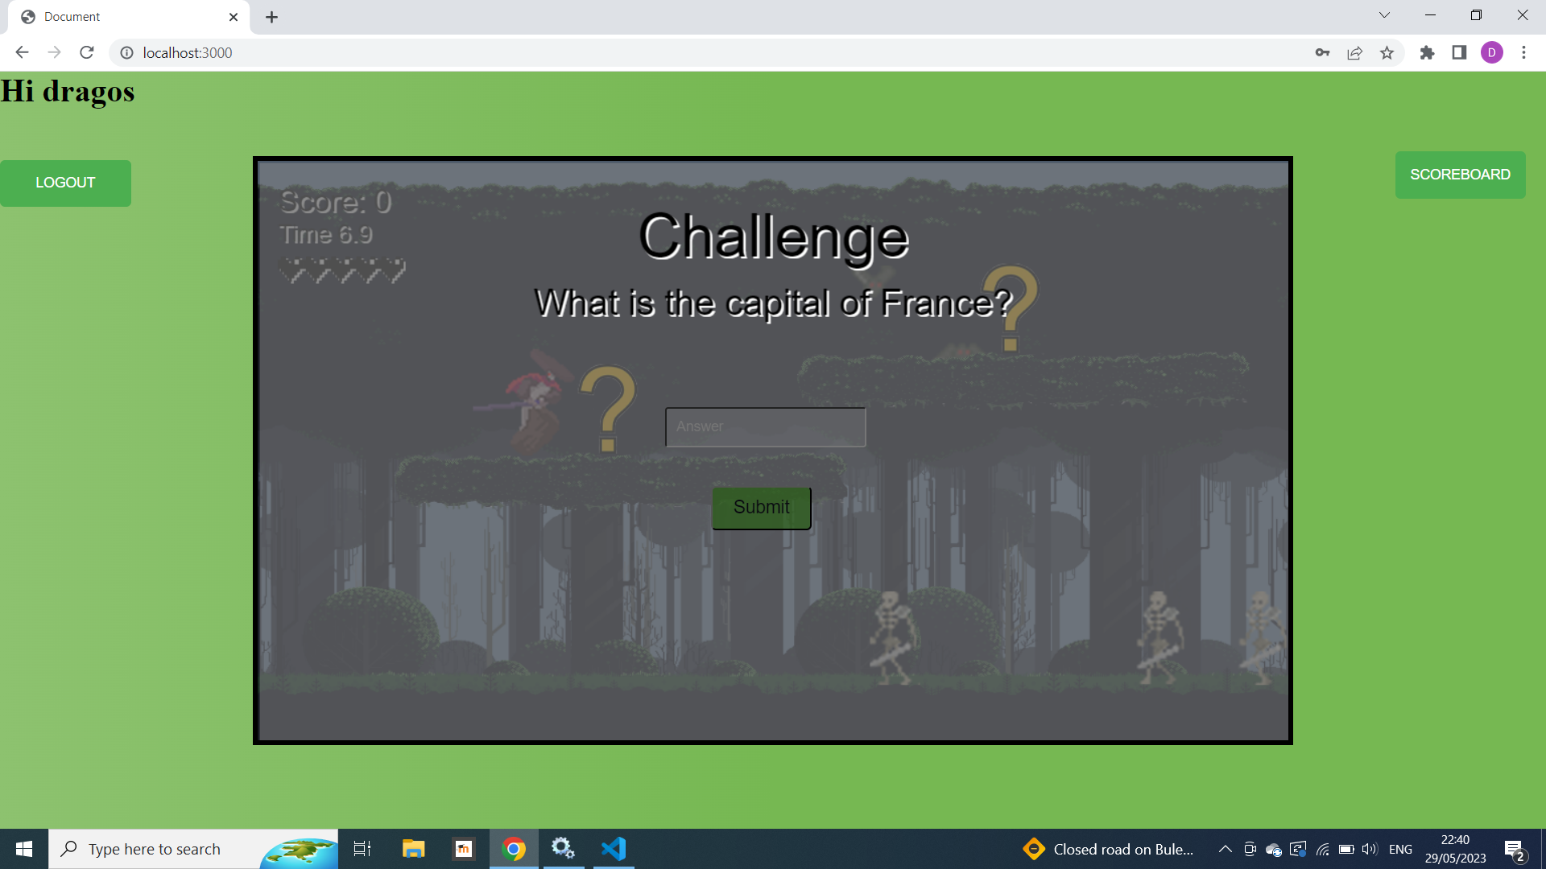
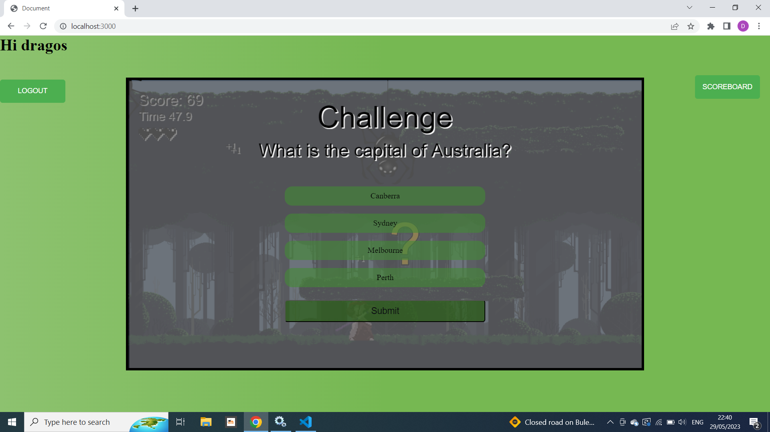
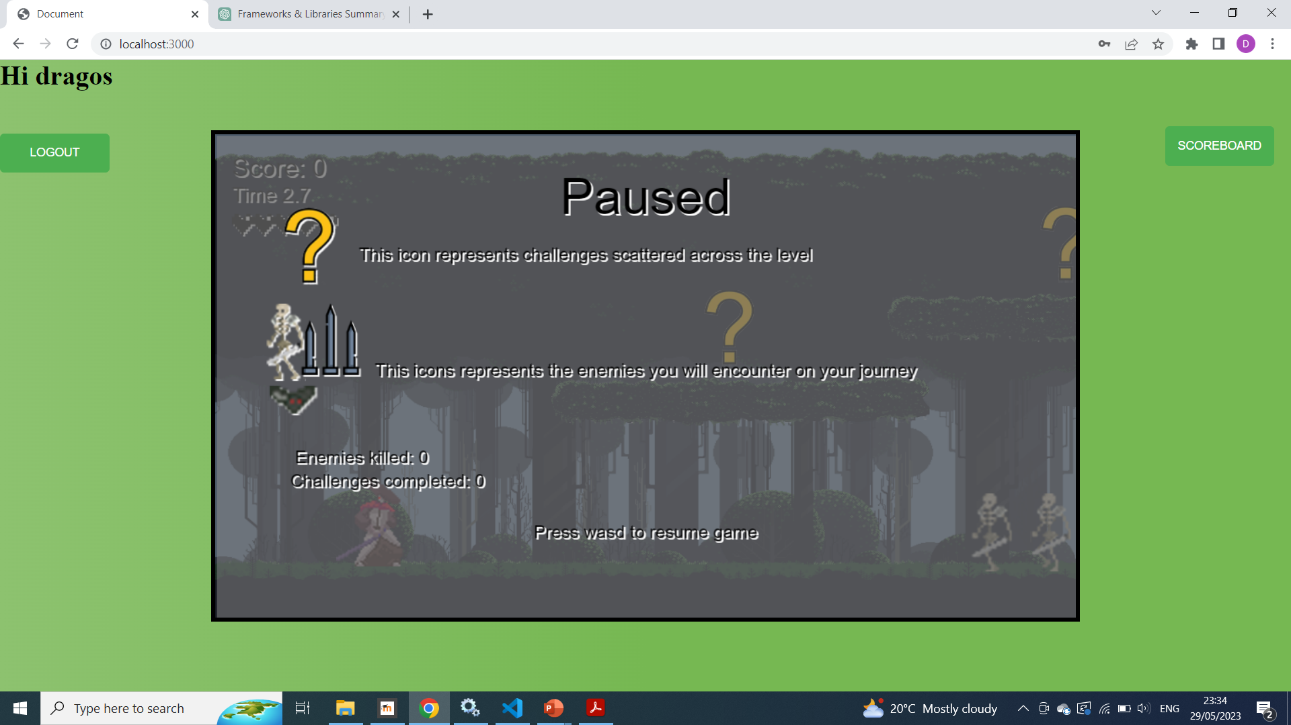
Challenges and pause ui
The first two screenshots represent the UI for the two challenges available on the platforms. First one contains question whose answer will be written in the display and submitted. This question, if correct, adds 7 to the score. There is a second type of challenge containing a question with four options with a plus 5 to the score if correct.
Third screenshot represents a pause UI, activated when pressing the esc button.

Slide 13
conclusion
I plan on working on all the objectives mentioned and on refining the already implemented elements. The game is a result of my effort and creativity, showcasing my skills in game development and graphic design and I hope that I can improve as much as possible.

Slide 14
THANK YOU

